Slide 2
The Digital Media Commons
Supports the creation and use of multimedia in education, scholarship, and creative expression. Provide services that include hands-on training, assistance with digital projects, and access to the essential tools for creating digital resources such as digital video and audio, images and animations, PowerPoint presentations, web pages, and more.
library.rice.edu/dmc

Slide 3
DMC Equipment
Equipment to check out
Video cameras, Digital SLRs, Green Screen, Adapters, Lighting kits, tablets, tripods, projectors, audio recorders, microphones, laptops.
Equipment for use at DMC
Printers, plotters, scanners, TVs, dual deck, media players, computers, workstations, audio/video/photography studios.

Slide 4
DMC Short Courses
Photography
Photoshop, iPhoto, Lens, Landscape/Portrait
Web and Graphics
WordPress, Illustrator, InDesign
Research
Zotero, EndNote, Infographics, Open Refine
Audio/Video
Video editing using iMovie & Final Cut Pro, Recording interviews

Slide 5
DMC Short Courses for MLS
Managing Citations with Zotero
Wednesday, October 14, 2015
5:00 - 6:00pm
Create a Web Site Using WordPress
Illustrator Workshop – Introduction
Managing Your Citations with Zotero
Introduction to EndNote
Video Editing with iMovie
Video Editing with Final Cut Pro X

Slide 6
Graduate Student Association
The Graduate Student Association of Rice University is the inclusive governing body of all Rice students enrolled in a graduate-level degree program.
The GSA mission is to enrich the graduate student experience and to represent, support, and promote graduate student interests and values.
gsa.rice.edu

Slide 7
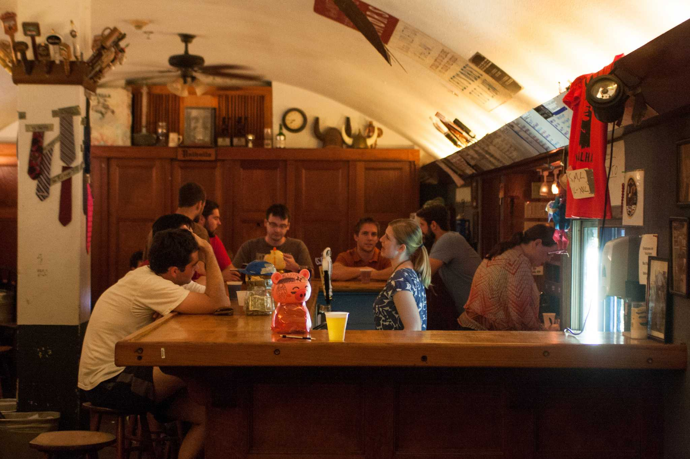
About GSA
Membership Dues
Department Representatives
Officers
Committees
Service
Awards
Representation
Funding
Events
Valhalla

