Slide 1
Online Education at JHU
Fully Online Courses in Program Division since 1999 in first Biotech and Environmental Sciences
Web supported courses in MLA since 2000
Internal Online Training and Course Design to work with Faculty – Now called the IRC
Fully online programs in program division (AAP) include Biotech, Bioinformatics, Museum Studies
AAP % - By 2014 , 50% of courses in AAP are online
MLA % - By 2014 we now have 12 courses fully developed and taught online
Delivery systems have included since 2000:
E-College/E-Companion
WebCt
Sakai
Blackboard

Slide 2
MLA-Online at JHU
Progress, Perils, and Pitfalls
Progress in MLA –Online
12 courses now fully developed, faculty trained, and already taught online
Two new initiatives include a fully online leadership certificate and a fully online lean pathway to degree for Masters program
Perils and Pitfalls
Faculty Training
Designing a Curriculum for a broad based liberal arts program – Keeping the Core!
Maintaining a balance between online and onground courses – Major issues for students and faculty
Dealing with administrators who don’t understand issues in pedagogy and balance
Biggest problem !!!!!!!!!!

Slide 3
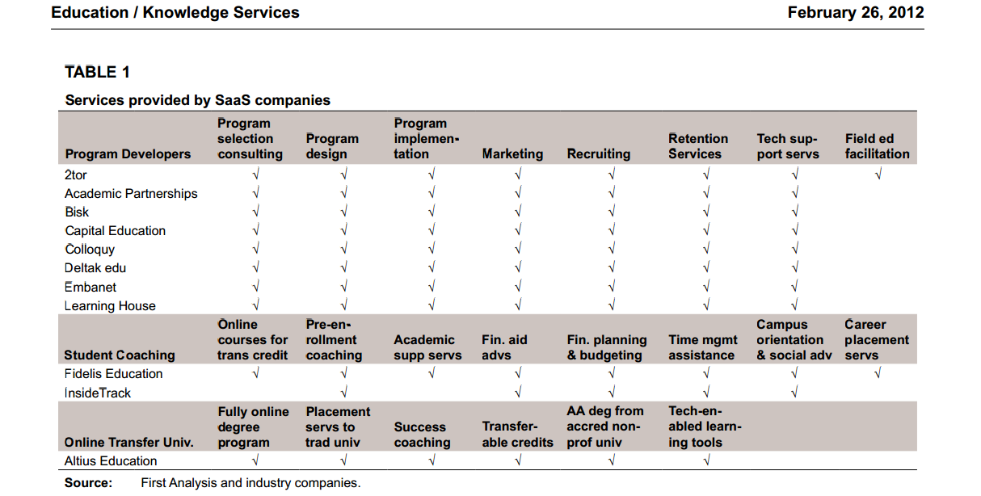
The Privatization of online Education and the University’s rush headlong into the money (?)
First Analysis Securities Corporation Report – “Education/Knowledge Services”
“School as a Service: The Next Big thing in the Higher Education Industry”

Slide 4
In 2012, Wiley Publishing purchased Deltak
“Deltak is a high-growth company that works in close partnership with leading colleges and universities to develop and support fully online degree and certificate programs. The business, founded in 1997, provides technology platforms and services including market research validating program demand, instructional design, marketing, and student recruitment and retention services to leading national and regional colleges and universities throughout the United States to achieve strategic outcomes with online and hybrid program offerings. Today, Deltak supports more than 100 online programs.”
Including Purdue, Saint Joseph’s, Boston University and now Johns Hopkins

Slide 5
“While for-profit institutions have yet to earn much respect from traditional higher education, the BSPs are working with scores of highly reputable nonprofits. EmbanetCompass works with Boston University, Deltak with Purdue, 2U with the University of Southern California and Georgetown, Pearson with Arizona State University, Bisk with Notre Dame -- and the list goes on.
Eduventures estimates that about 200 nonprofits have partnerships with BSPs and another 500 will entertain such partnerships in the next 12 to 24 months. BSPs generally take 50 percent of all tuition revenues for their services, so this is a very lucrative market.”
* “Bundled Services Providers”
“The New For-Profits” in Inside Higher Education (May 31, 2013)
So What’s the Problem with This??!!

