Slide 1
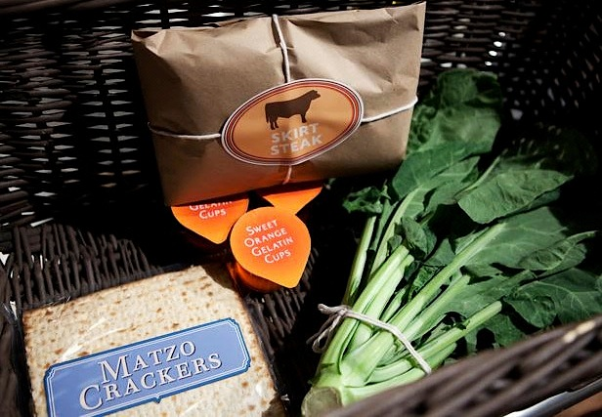
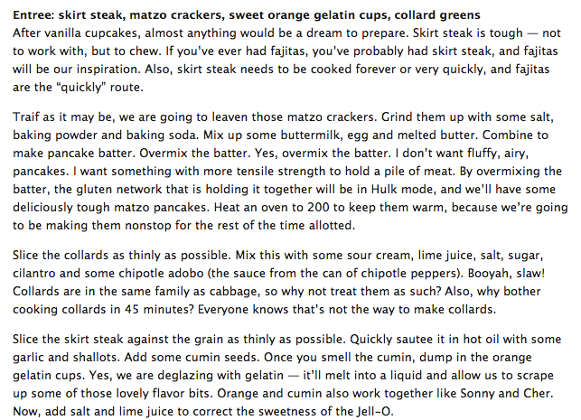
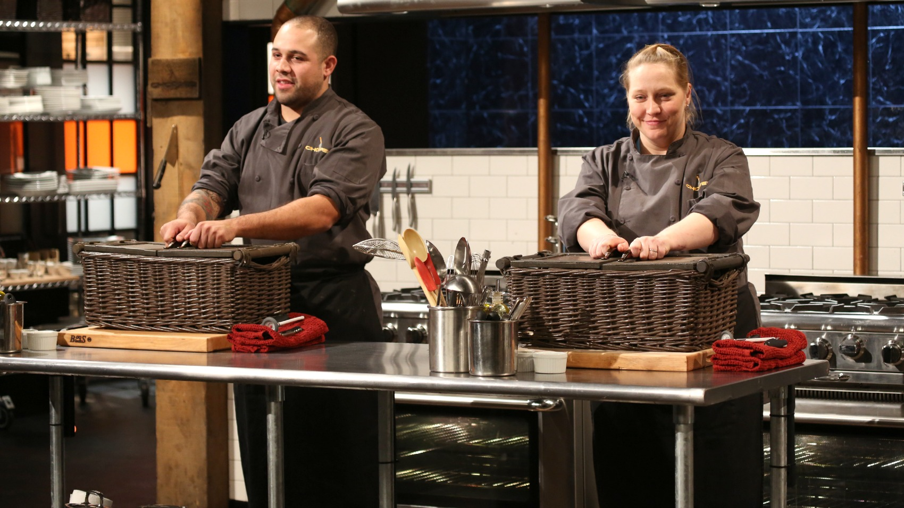
Making the Most of Existing Resources
AGLSP Pre-Conference Workshop, October 15, 2015
Organized by Michael Garval and Marylu Hill

Slide 2
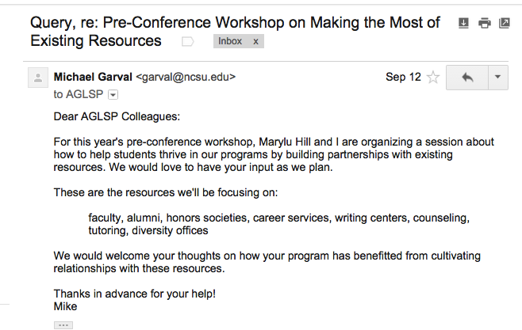

Slide 3
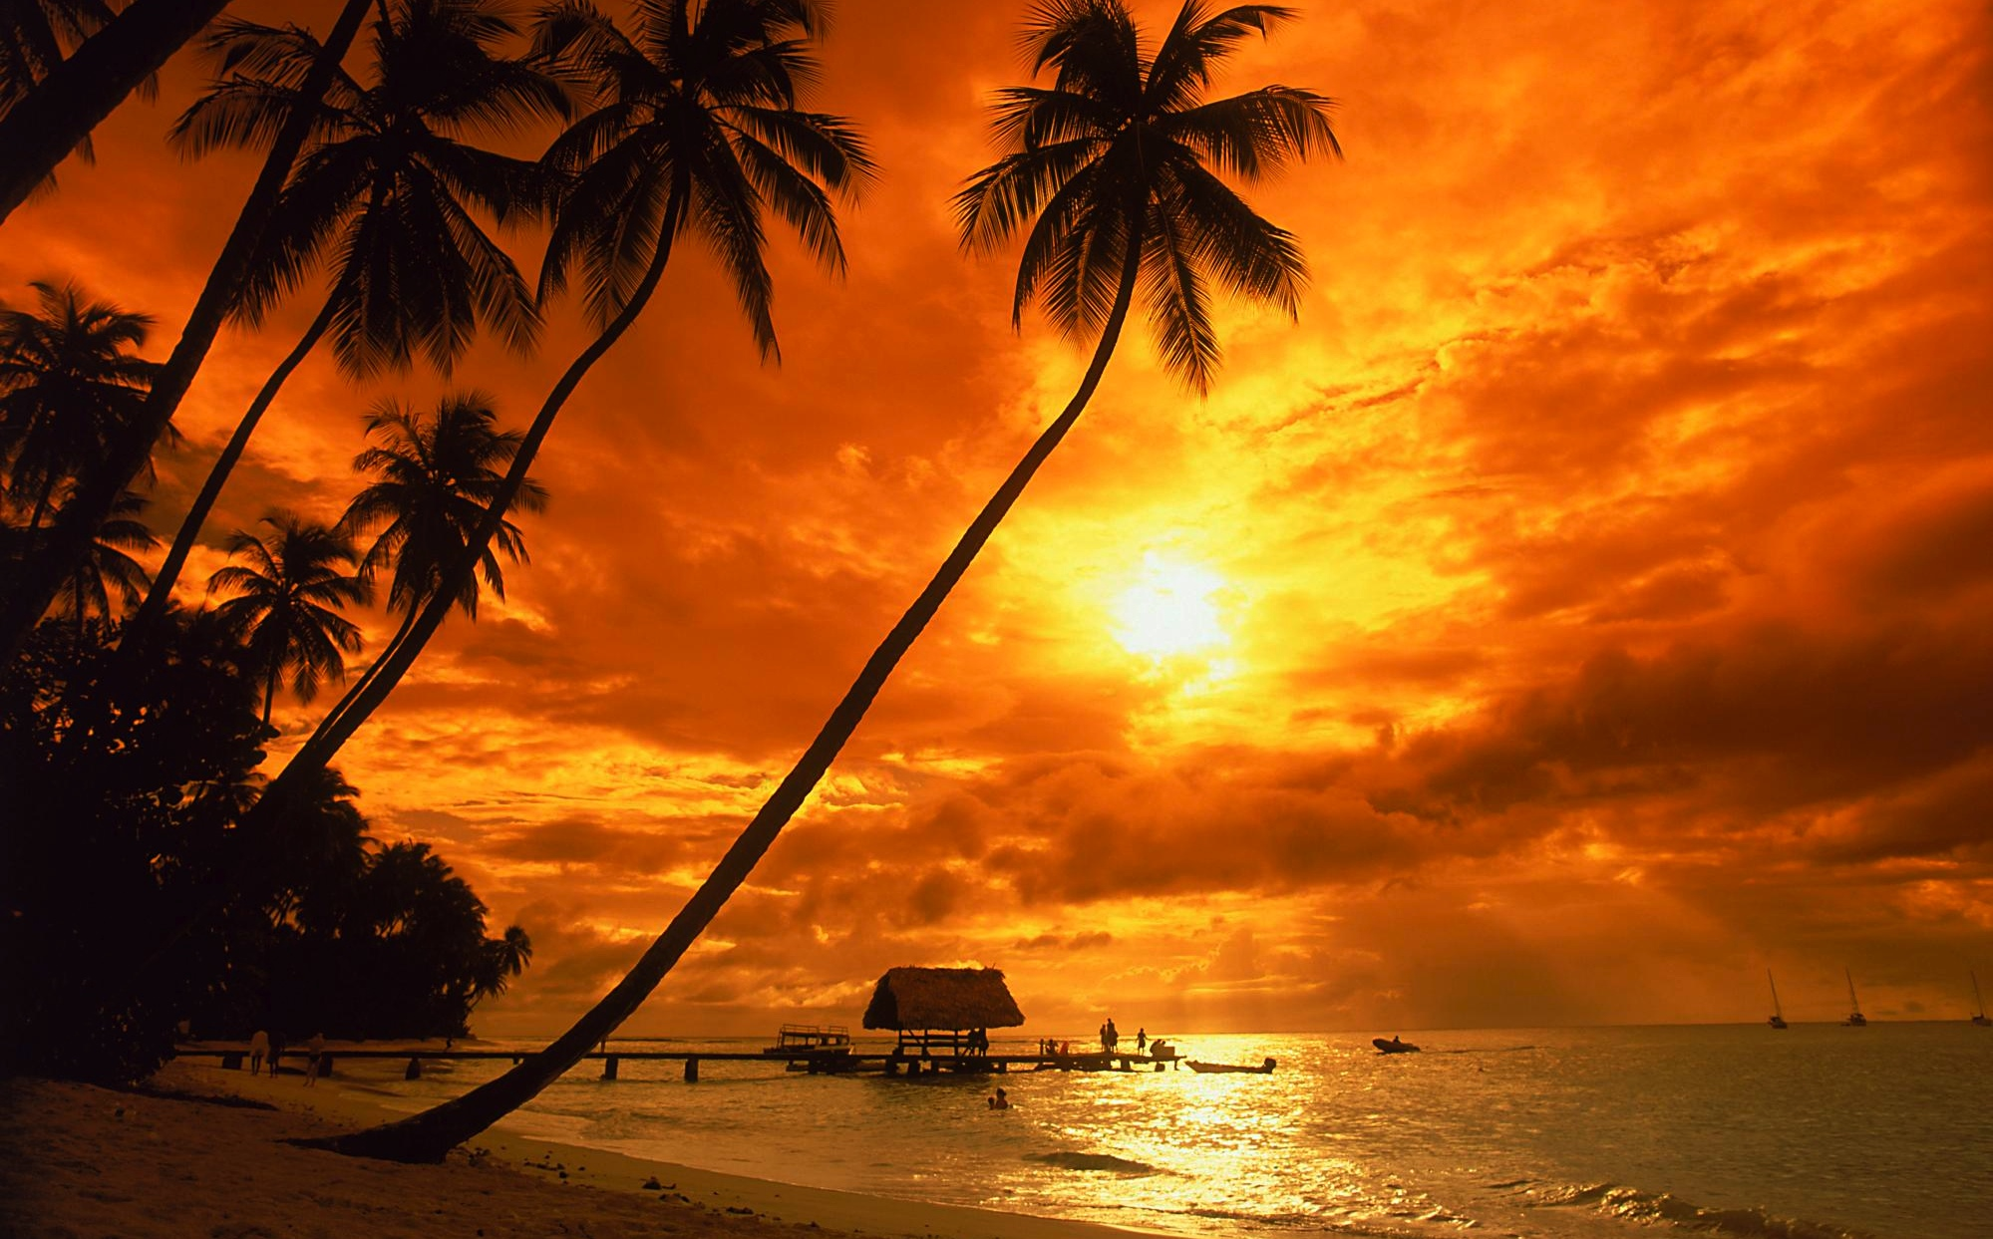
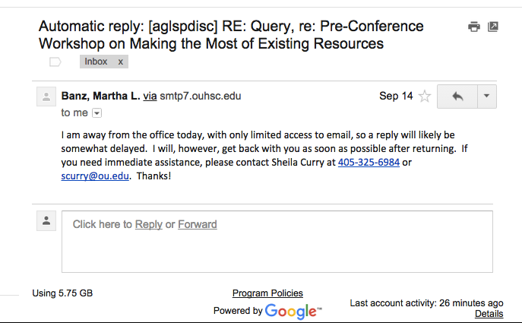

Slide 4
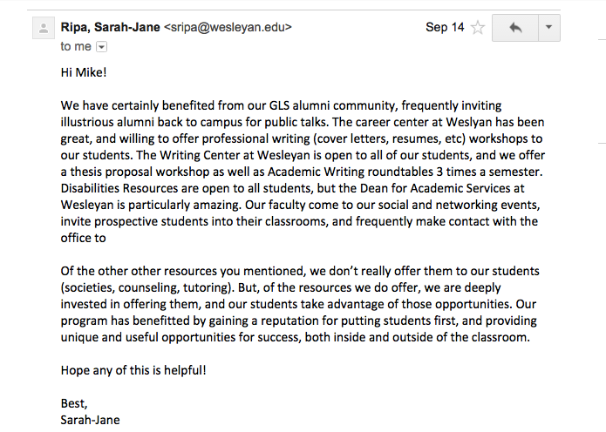

Slide 5
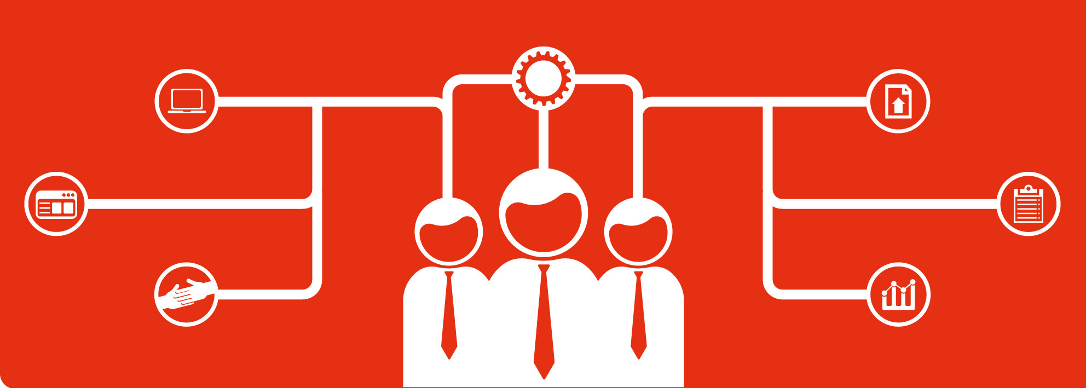
(Stupid corporate graphic illustrating
diverse solutions to a problem.)

Slide 6
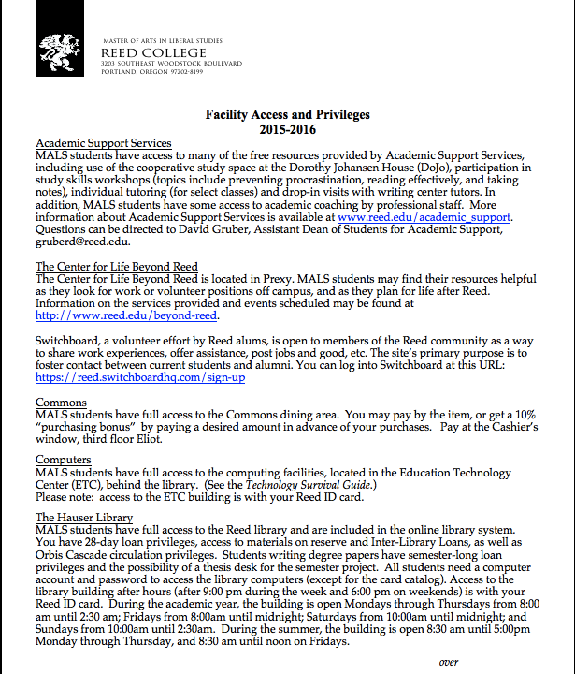

Slide 7
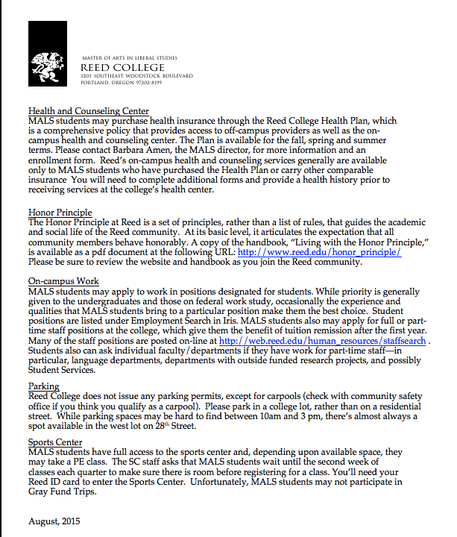

Slide 8
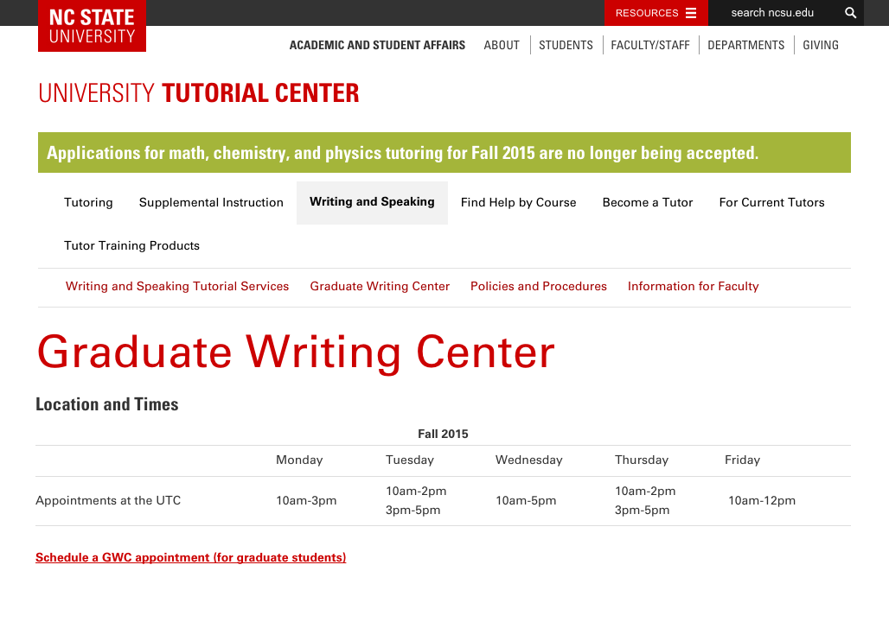

Slide 9
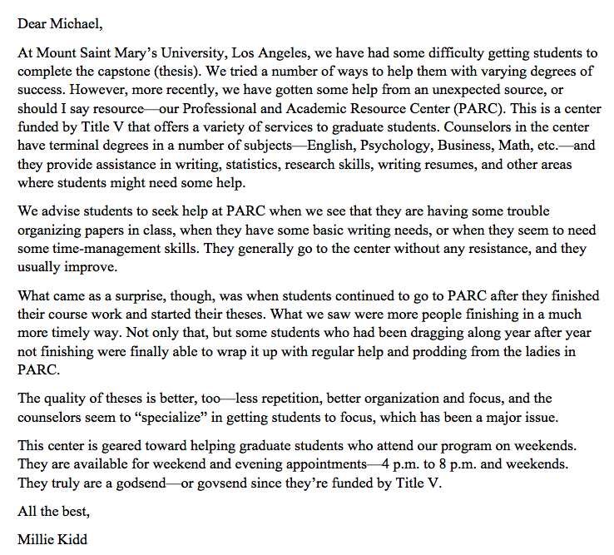

Slide 10
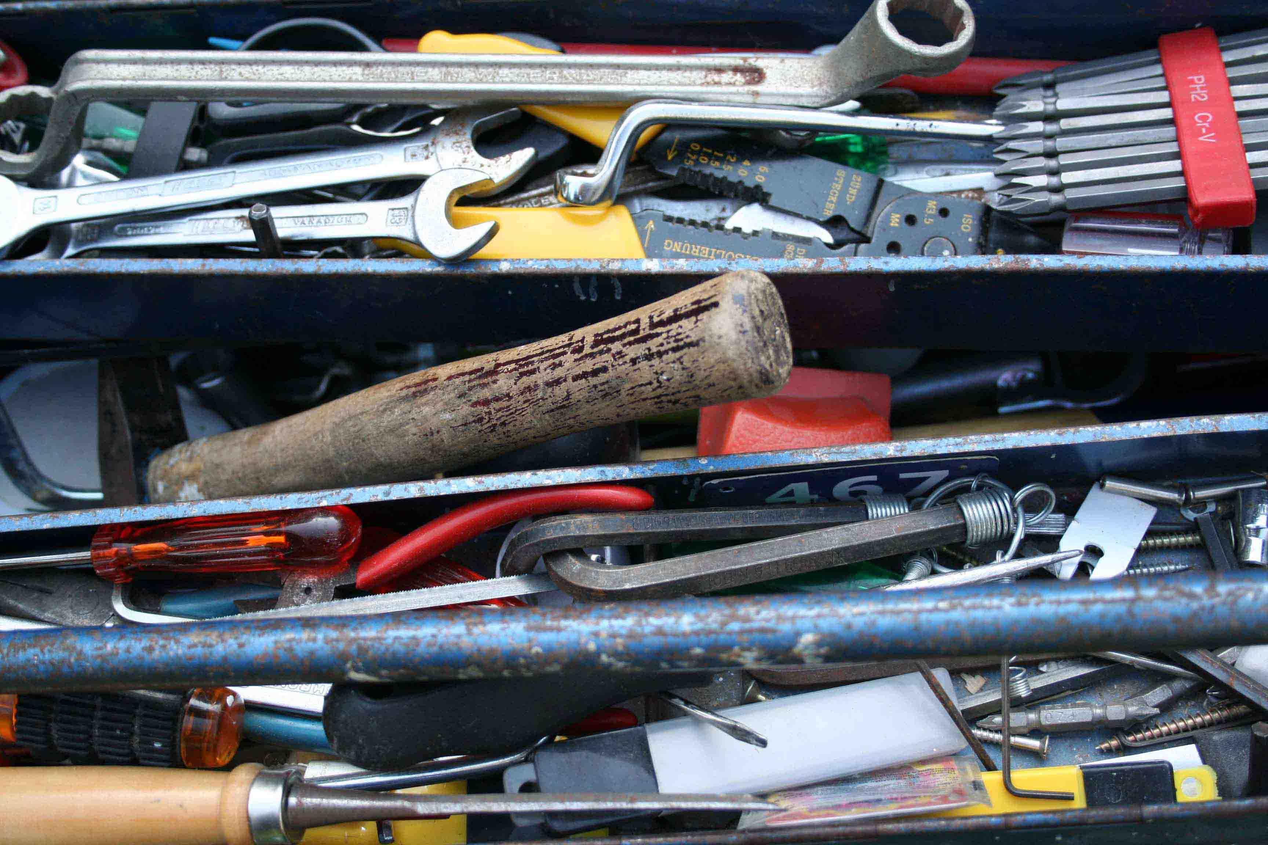
What are “existing resources”?

Slide 11
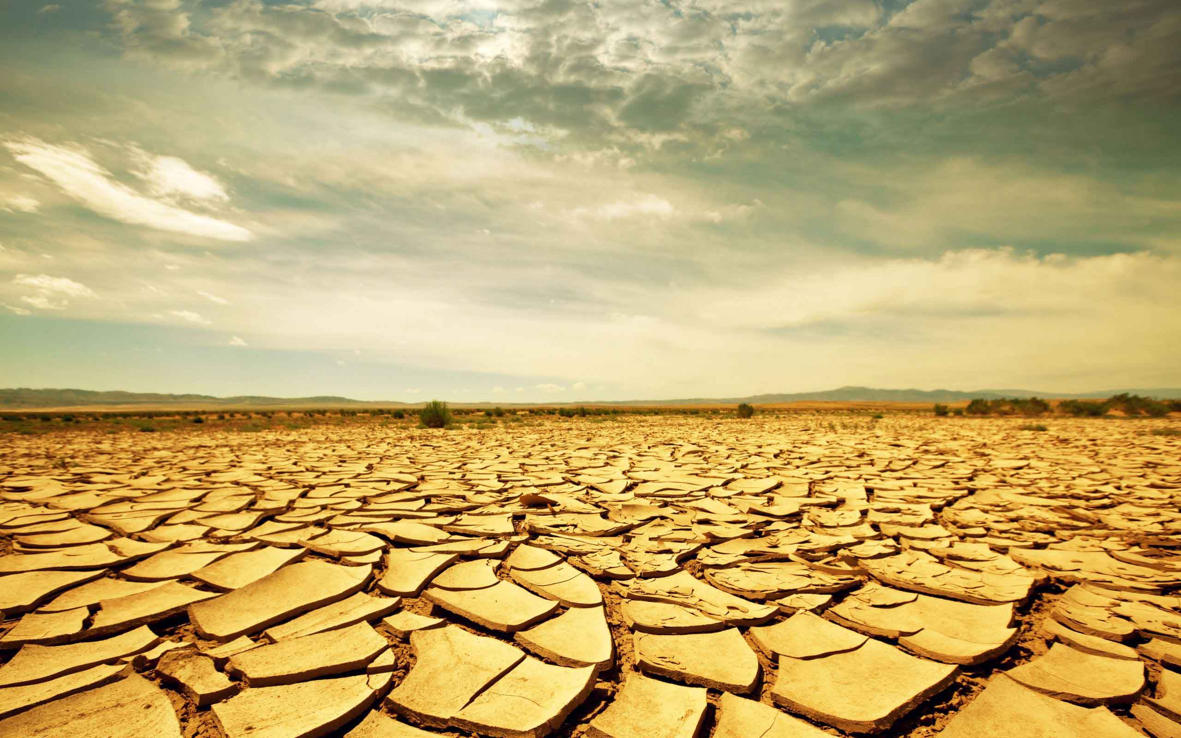
Looking for resources in all the wrong places?

Slide 12
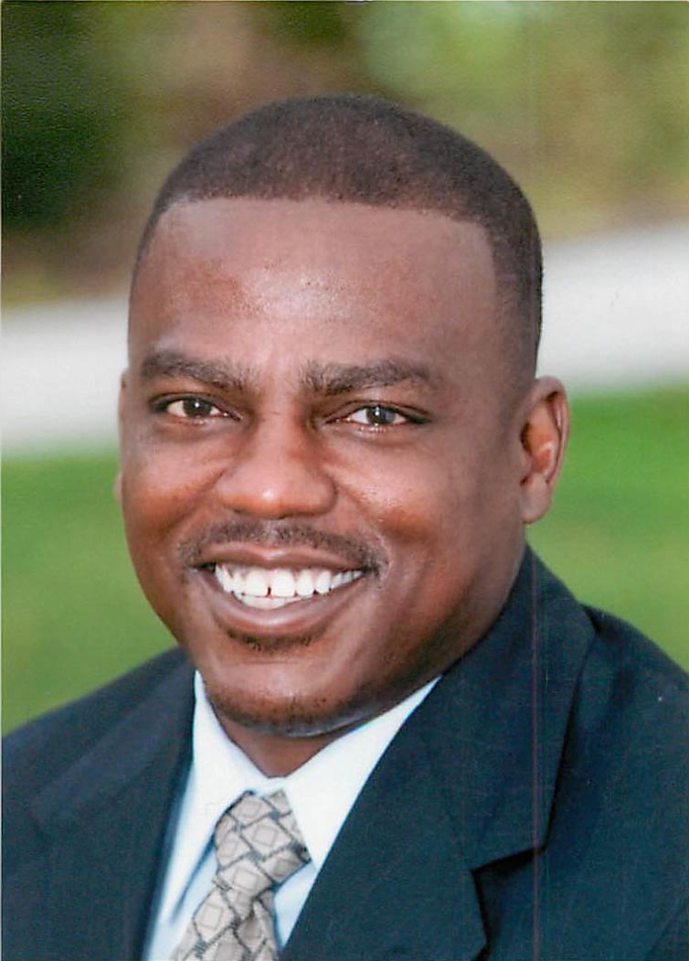
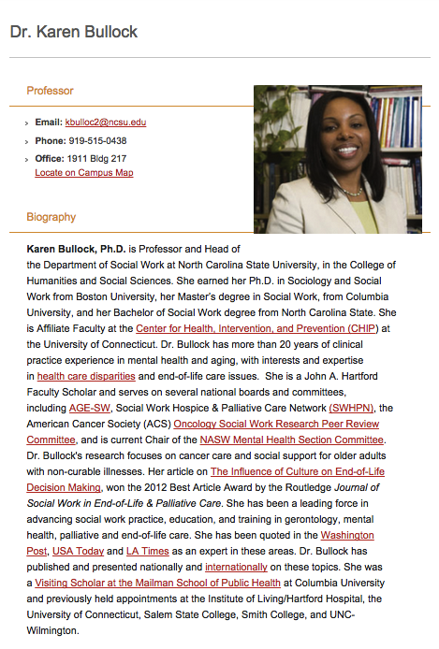
Joe Johnson, Student Diversity Coordinator

Slide 13
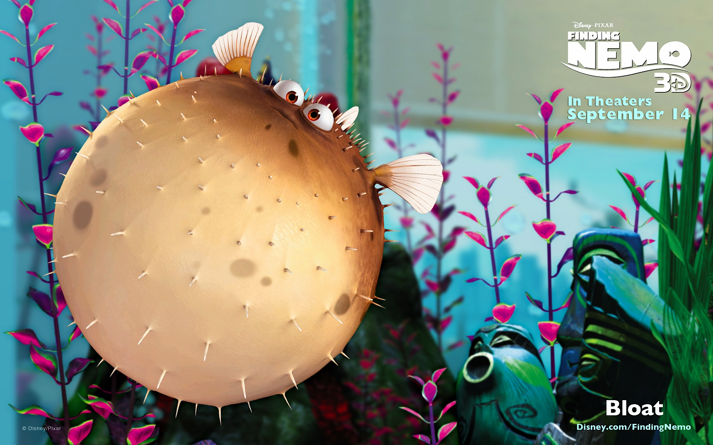

Slide 14
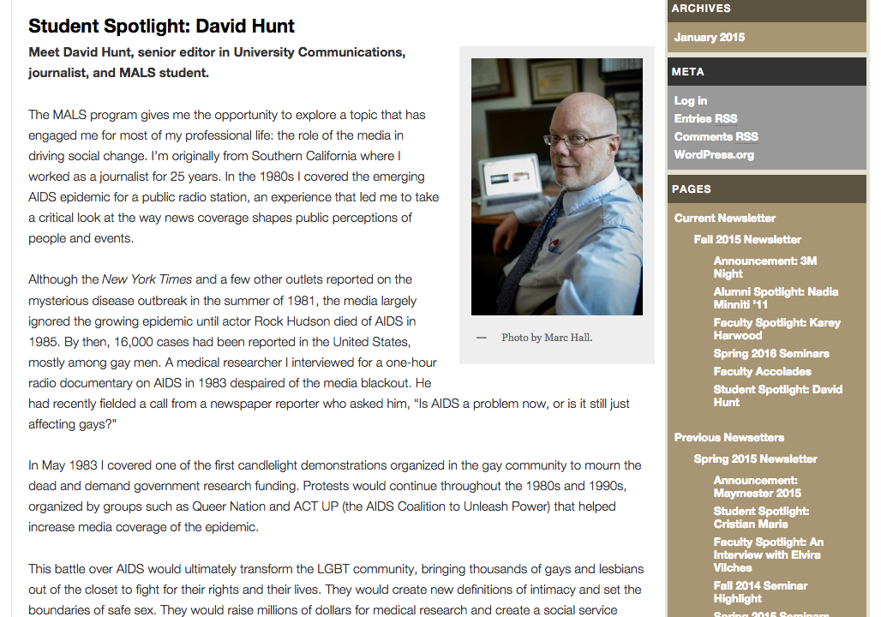
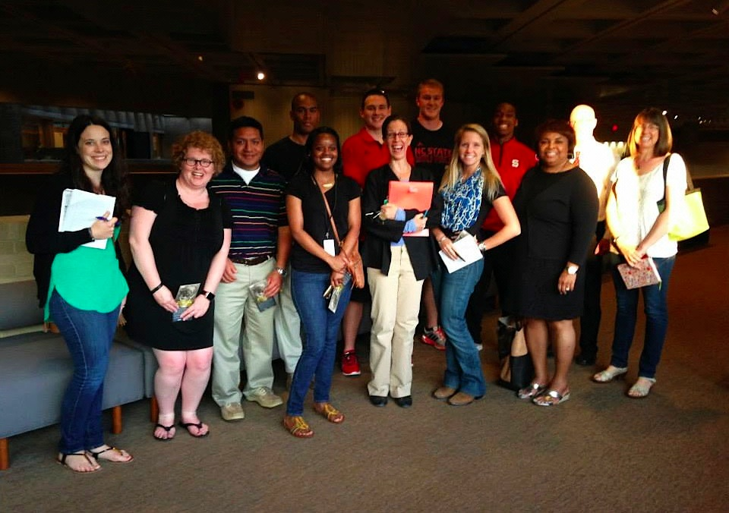
Prof. Shelley Garrigan’s MALS Seminar,“Triangle Museums in Local, National, and Global Contexts”

Slide 15
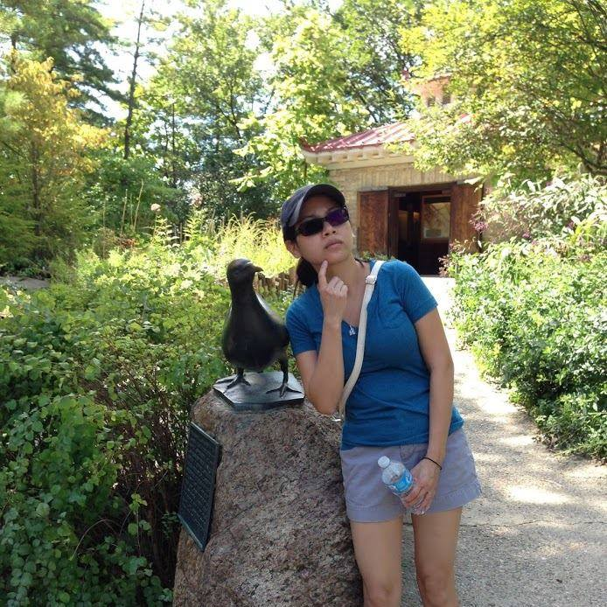
Mya Nguyen, MALS Program Associate

Slide 16
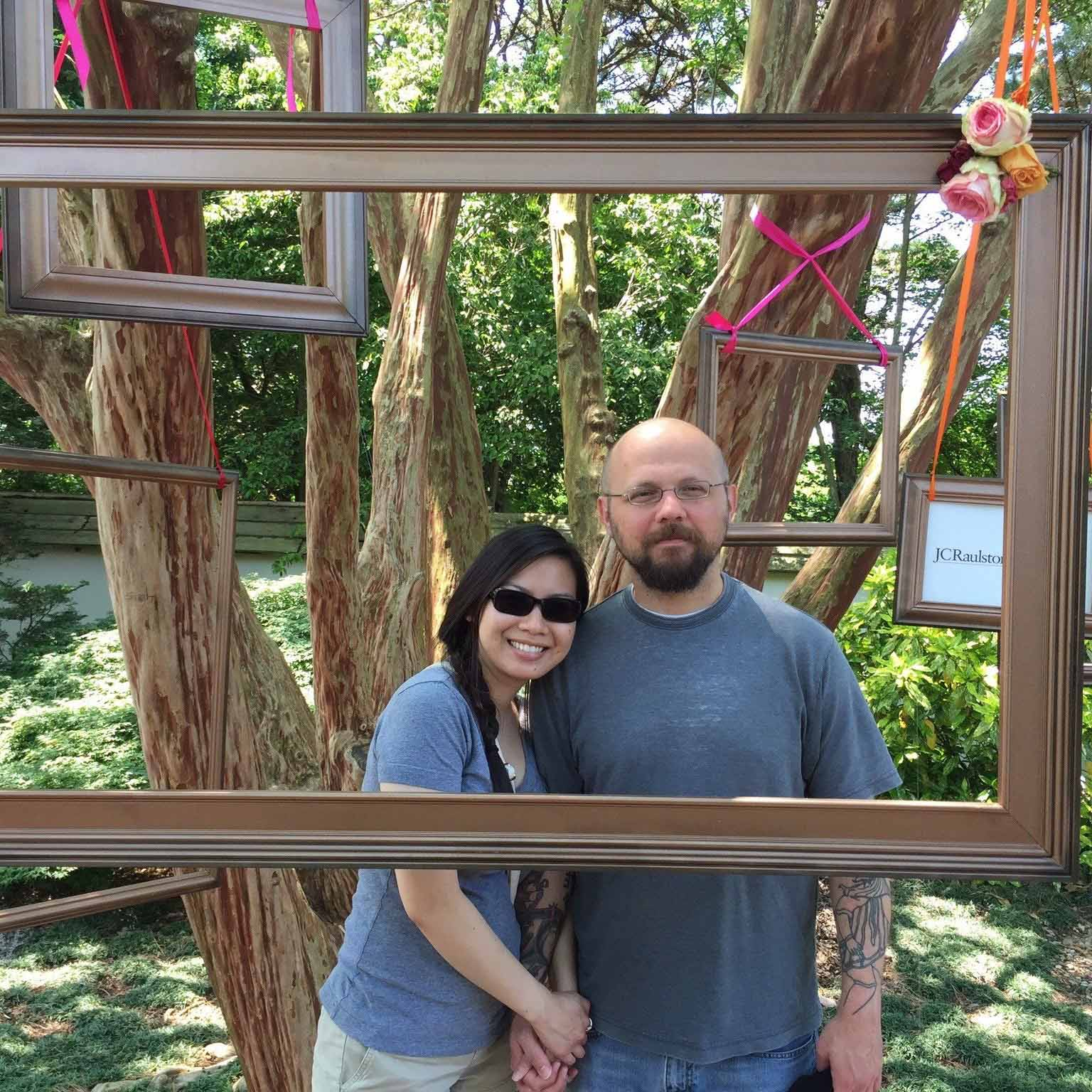
Mya & James

Slide 17
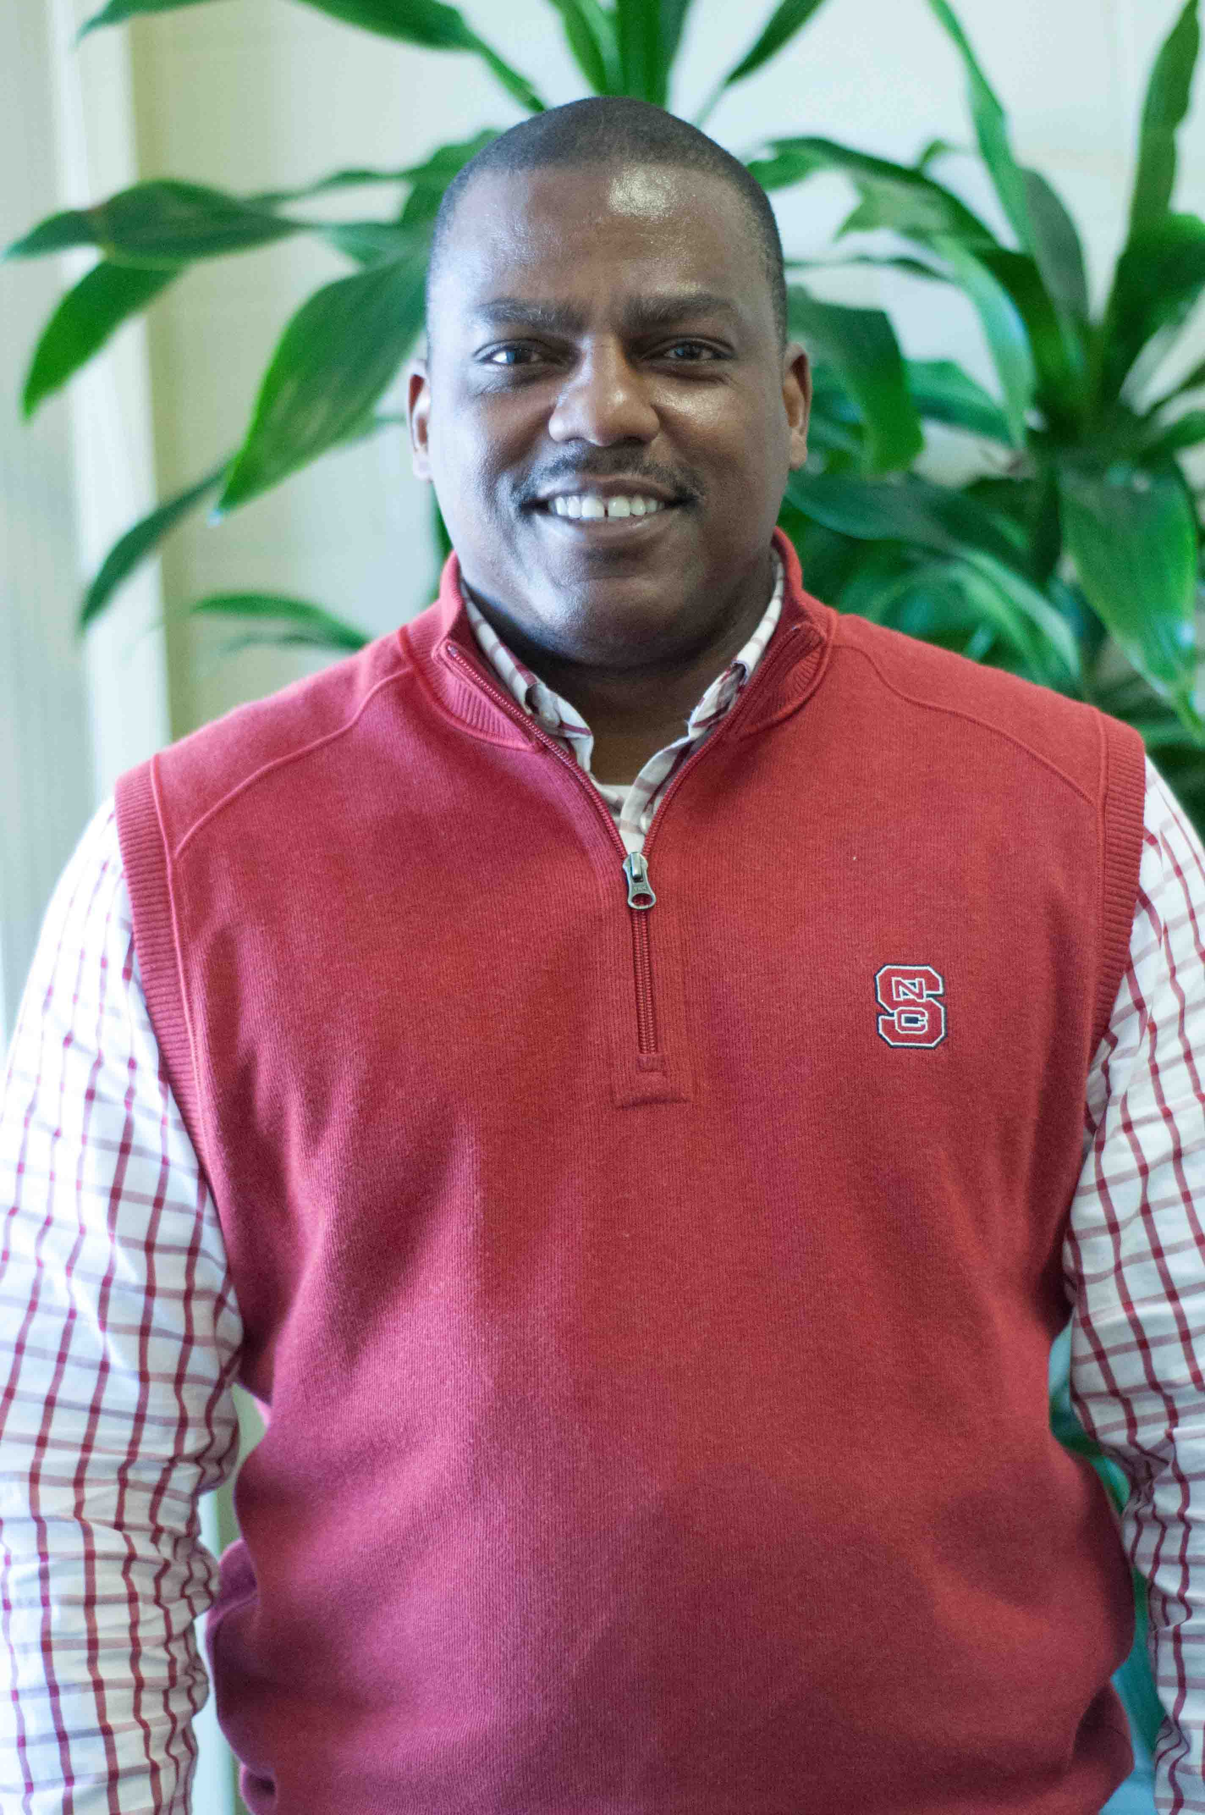
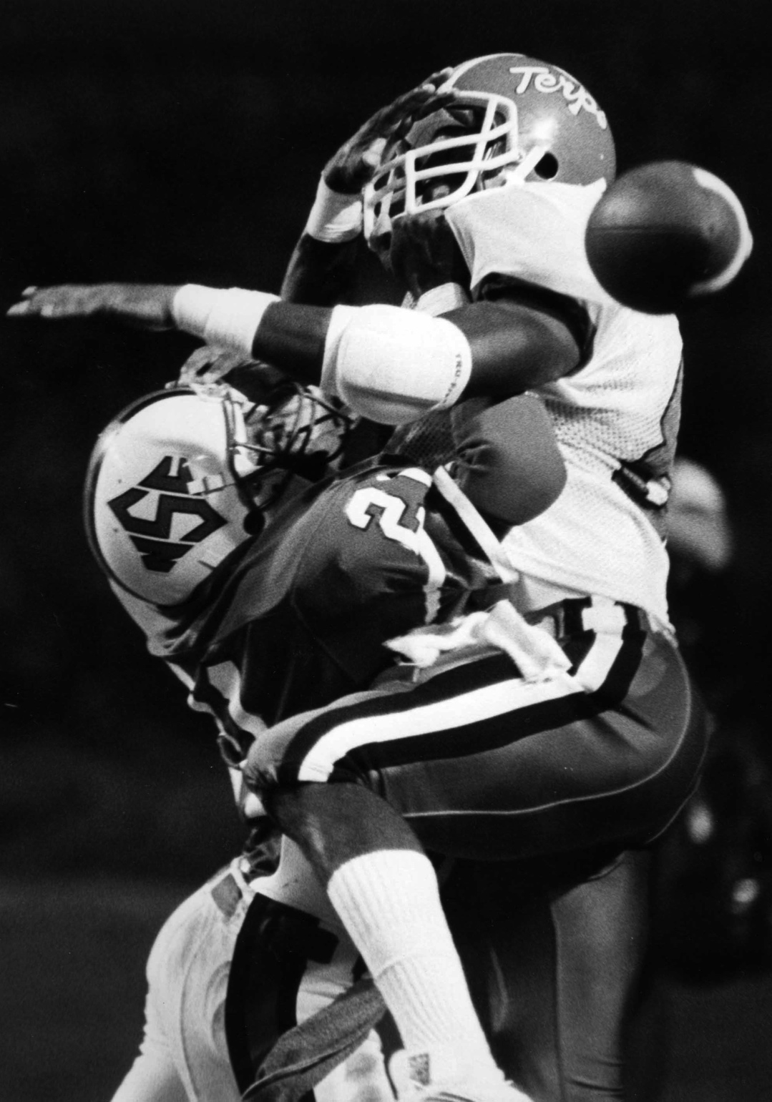

Slide 20
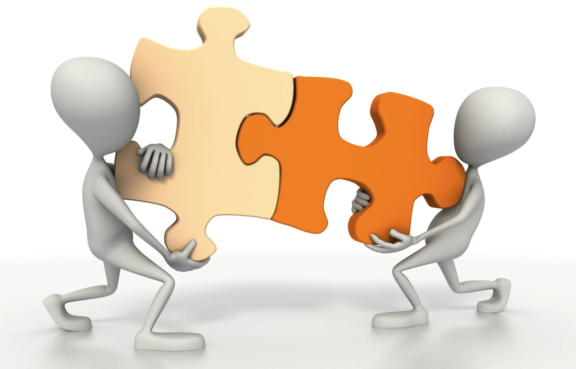
(Another stupid graphic: managing relationships.)

Slide 21
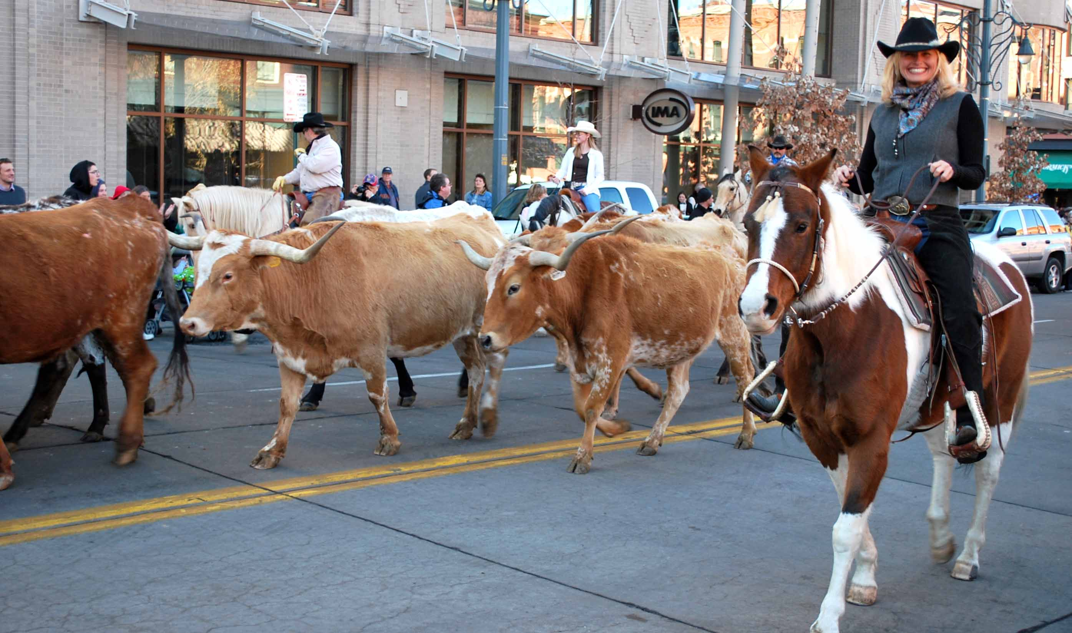
Anne Ridder
Georgetown University
Rebecca Sharp Sanchez
Rice University
Sarah-Jane Ripa
Wesleyan University

