Slide 1
Liberal Studies Traditions and the Role of Intellectual Entrepreneurship
October 20, 2016

Slide 2
“In ancient Greece, the liberal arts were intended to produce the ideal citizen: a person of intelligence, with sensible moral judgment and the ability to reason.
Today the purpose of an education on that model is to create a well-rounded student who can relate diverse fields of study and connect apparently disparate thoughts and ideas.”
“The Liberal Arts in the Real World,” The Chronicle of Higher Education

Slide 3
Liberal Studies Traditions

Slide 4
Liberal Studies Traditions
Philosophical
Focus on the preparation for inquiry
Freeing the mind to investigate physical, intellectual, and spiritual truths
Rhetorical
Initiates a common culture through the study of canonical works
Appreciate its monuments
Create new monuments inspired by the old
Utilitarian
Generate useful knowledge to benefit society
Beyond the University: Why Liberal Education Matters

Slide 5
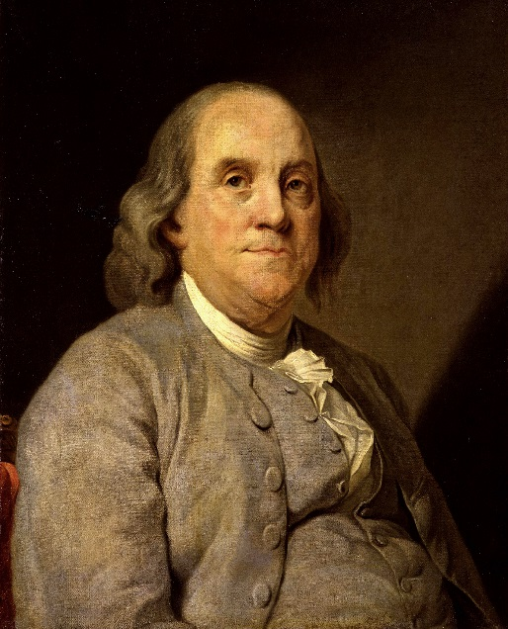
Graduate Liberal Studies Traditions
Thomas Jefferson
Valued knowledge but insisted it be useful to human progress.
Education was the guardian of freedom.
Cultivation of independent judgment was necessary to inspire a new democracy’s pursuit of happiness.
Benjamin Franklin
Encouraged a liberal arts-based, practical, and interdisciplinary learning
Application of knowledge in “service to society” to the local community and the wider world

Slide 6
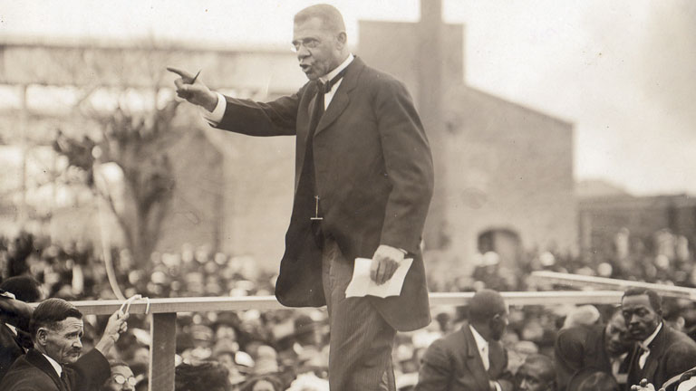
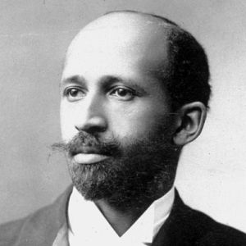
Graduate Liberal Studies Traditions
Booker T. Washington
Means to economic inclusion
Lead to higher pursuits
W.E.B. DuBois
More than just preparation for economic inclusion and getting a good job
Responsibility to help others attain their own freedom

Slide 7
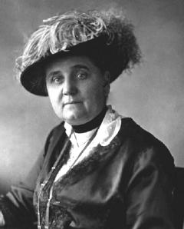
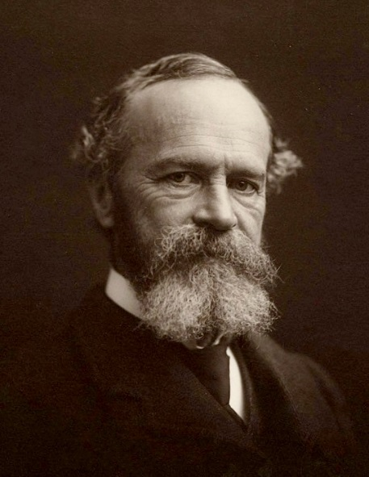
Graduate Liberal Studies Traditions
Jane Addams
Education should cultivate empathy and cooperation
William James
Study of literature to develop imagination
Help overcome blindness to other perspectives

Slide 8
Intellectual Entrepreneurship

Slide 9
Characteristics of the Entrepreneurial Spirit
In-tune with their passion.
Questioning how it can be done better.
Optimistic about all possibilities
Take calculated risks
Above all, they execute well
Inc.com

Slide 10
Intellectual Entrepreneurship
Innovative mechanisms organize and leverage academe's intellectual capital to transform lives for the benefit of society.
It requires us to acknowledge that a university's collective wisdom is among its most precious assets -- anchored to, but not in competition with, basic research and disciplinary knowledge -- and that part of the significance of such wisdom is tied to its use.
“Intellectual Entrepreneurship: The New Social Compact,” Inside Higher Ed

Slide 11
Intellectual Entrepreneurship
Universities face tremendous challenges: dwindling fiscal support, deterioration of public sympathy, and the need to create supportive communities.
The stakes could not be higher. It is time to stop obsessing over various “scandals of the moment” and think seriously about our long-term future and the role university systems must play in it.
“Academics Are Intellectual Entrepreneurs,” Association of American Colleges and Universities

Slide 12
Intellectual Entrepreneurship
Intellectual capital is the cumulative product of both individual effort and supportive communities.
Intellectual capital is the dividend of years of hard work and practical experience that bears fruit by transforming lives and benefiting society.
The best academics are, in the words of Cherwitz, “intellectual entrepreneurs--scholars who take risks and seize opportunities, discover and create knowledge, innovate, collaborate, and solve problems in any number of social realms” (Cherwitz 2002).
“Academics Are Intellectual Entrepreneurs,” Association of American Colleges and Universities

Slide 13
Intellectual Entrepreneurship
transform lives
discover and create knowledge
dwindling fiscal support
benefit of society
need to support communities
university's collective wisdom is among its most precious assets
take calculated risks and seize opportunities
long-term future and the role of the university

Slide 14
SMU/Baylor - Medical Humanities Example
Origination of opportunity
Course/faculty selection
Concentration – MLS growth
DLS extension
Going forward

Slide 15
Intellectual Entrepreneurship Examples on How to Position Liberal Arts/Studies in Professionally

Slide 16
Intellectual Entrepreneurship Examples
"It's in Apple's DNA that technology alone is not enough -- it's technology married with liberal arts, married with the humanities, that yields us the result that makes our heart sing, and nowhere is that more true than in these post-PC devices.“
- Steve Jobs

Slide 17
Intellectual Entrepreneurship Examples
The American workplace is now one that demands creativity, innovation, empathy and a command of the big picture.
The MFA is the new MBA

Slide 18
Intellectual Entrepreneurship How Graduate Liberal Programs Position Themselves Today

Slide 19
Graduate Liberal Programs Today
Graduate Liberal Studies
Graduate liberal studies education allows each student the intellectual and personal freedom to chart his or her own self-directed course to a master’s degree, advanced certificate, and/or doctoral degree without the typical constraints or requirements of a traditional graduate program.
Doctor of Liberal Studies – Designed for the experienced adult learner who has earned a master’s degree. These intellectually serious adult students who, by focusing on their own advanced personal and professional growth, will make high-level contributions to their workplace, society and the world.

Slide 20
Graduate Liberal Programs Today
The Purpose of Interdisciplinary Studies
An interdisciplinary education gives a greater appreciation for the literature, music, and visual arts that society offers us. It helps us to comprehend the complex social and political programs of the contemporary world and facilitates our ability to make use of today's rapidly evolving technology.
An Individualized Program of Study
The Master of Interdisciplinary Studies program is designed to allow students flexibility to fashion a course of study that blends their interests, talents and experience.

Slide 21
Graduate Liberal Programs Today
The road less traveled
Your journey to the Master of Liberal Arts (MLA) at Penn starts with you: your passions, your questions and your unique combination of academic interests. You state your goals, and we help you craft your course of study within the rigorous academic environment of the Ivy League.
A curriculum created with you, for you
The MLA offers intellectual explorers like you the opportunity to design your own curriculum at the intersection of your interests in the liberal arts.

Slide 22
Graduate Liberal Programs Today
The Master of Arts in Liberal Studies (MALS) degree at Duke University offers you a rich selection of seminars in subjects such as these within a graduate program that gives you the freedom to chart your own course of study. Flexible enough to accommodate the needs of both full-time and part-time students, the MALS degree is an opportunity to explore questions of enduring concern and contemporary urgency at one of the nation's leading institutions of higher learning.

Slide 23
Graduate Liberal Programs Today
Georgetown University's Master of Arts in Liberal Studies (MALS) program takes a more holistic approach than other master's programs, providing you with the skills and experience that form the bedrock for advancement or change in any career.
Knowledge is ineffective without understanding, and that understanding is achieved only through interaction. Georgetown's program focuses on the exchange of dialogue, ideas, and perspectives that define humanity and continue to influence daily experiences.
Courses have roots in the past with an eye to the future.

Slide 24
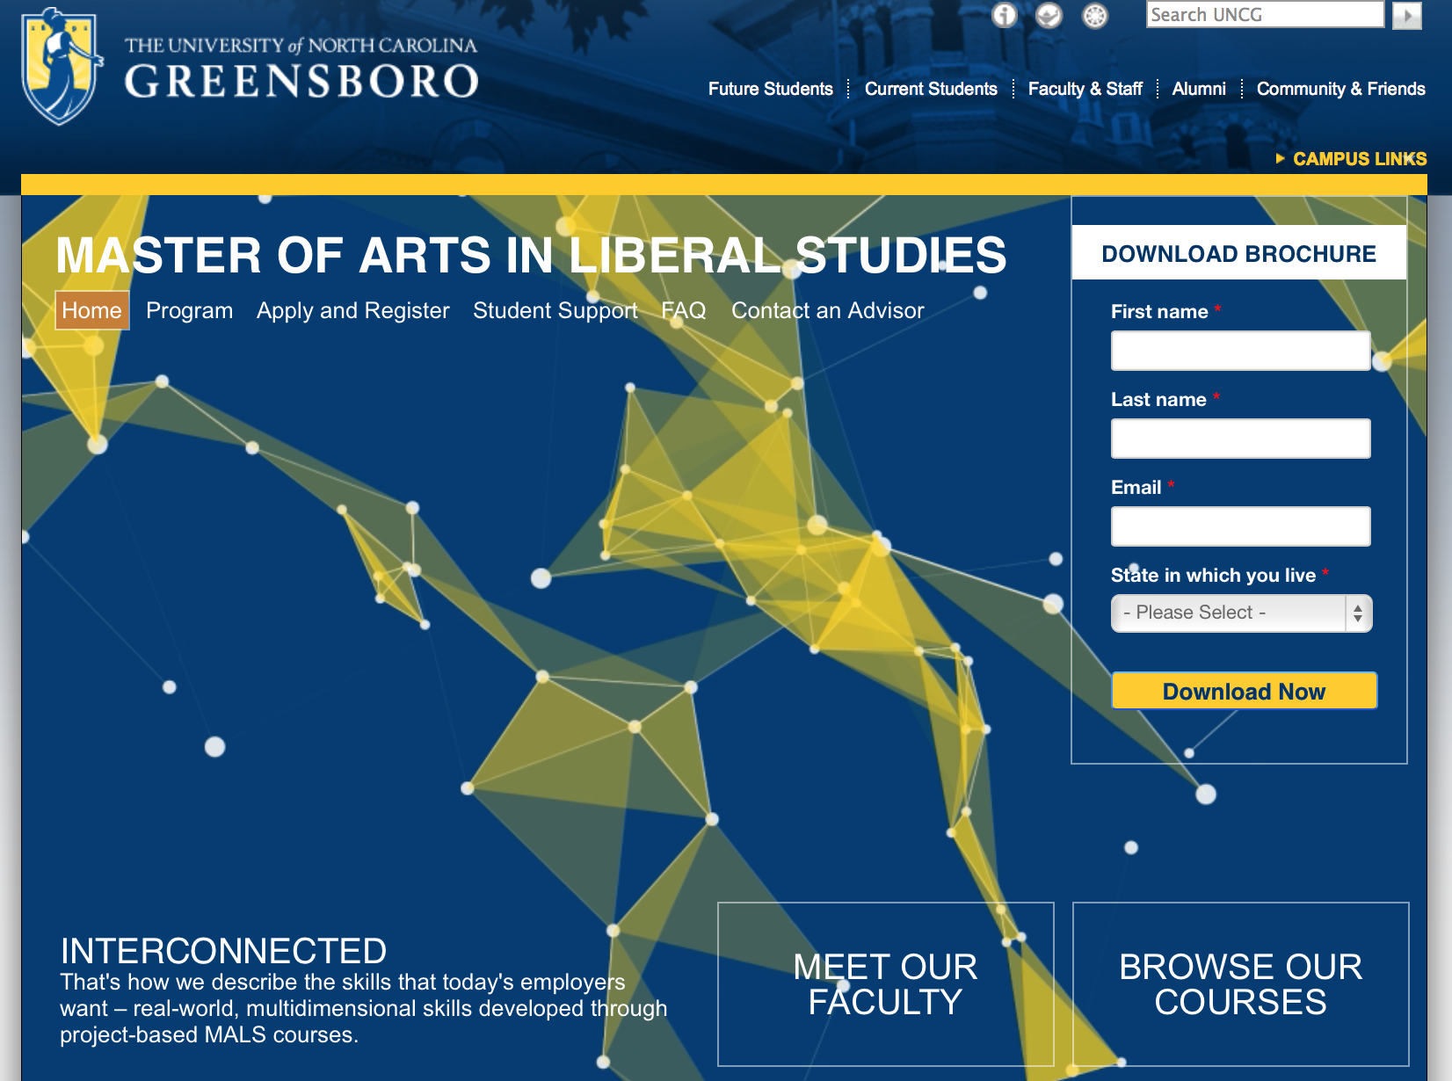
Graduate Liberal Programs Today

Slide 25
Questions for Group (Discussion as larger group or breakouts)
What aspects of your programs should be maintained in light of liberal studies traditions and university missions and goals?
What entrepreneurial approaches could be introduced to serve the needs of students in your communities?
What barriers do you anticipate to go down these new paths and how would you overcome them?

